Slide 1




NEXT GEN EMPLOYABILITY PROGRAM
Creating a future-ready workforce
Team Members
College Name
Student Name : THARANEESHWAR P
Student ID : 622021243059
Paavai college of engineering

Slide 2

CAPSTONE PROJECT SHOWCASE
Project Title
Building Bus Reservation System using Python and Django
Abstract | Problem Statement | Project Overview | Proposed Solution | Technology Used | Modelling & Results | Conclusion

Slide 3
Abstract
Online Bus Ticket Reservation System is a Web based application that works within a centralized network. This project presents a review on the software program "Online Bus Ticket Reservation System" as should be used in a bus transportation system, a facility which is used to reserve seats, cancellation of reservation and different types of route enquiries used on securing quick reservations. OBTRS is built for managing and computerizing the traditional database, ticket booking and tracking bus and travel made. It maintains all customer details, bus details, reservation details. In order to achieve the design, Imo Transport Company (ITC) was chosen as a case study because of its strategic importance to Imo State. Structured Systems Analysis and Design Methodology (SSADM) was adopted. In addition,Django language was used for the front-end of the software while the back end was designed using python The software achieved is capable of improving the customer hand and relationship management in ITC operations. It is recommended that despite the present functionality of the designed software, an additional functionality such as the use of E-mail to send tickets and notifications to the customer and an online payment using credit cards/debit cards should be implemented into the system. Furthermore, other operations carried by ITC such as the courier services should also be integrated in order to enhance the system.
Source : Researchgate.net

Slide 4
Problem Statement
Currently, the type of system being used at the counter is an internal system which
is manually used in selling the bus tickets. The problems facing the company are
that customers have to go to the counter to buy bus ticket or ask for bus schedule,
customers will also have to queue up for a long time in order to secure a bus ticket
and will also need to pay cash when they buy the bus ticket.
Source : researchgate.net

Slide 5
Project Overview
The main purpose of this project is to automate the manual procedures of reserving a
bus ticket for any journey made through reservation system. This
system is said to be an automatic system and customers can select seats by
themselves.
Source : researchgate.net

Slide 6
Proposed Solution
.
i) Providing a web-based bus ticket reservation function where a customer can
buy bus ticket through the online system without a need to queue up at the
counter to purchase a bus ticket.
ii) Enabling customers to check the availability and types of busses online.
Customer can check the time departure for every ITC bus through the
system.
iii) Easing bus ticket payment by obtaining a bank pin after payments is made to
the various designated banks.
iv) Ability of customers to cancel their reservation.
v) Admin user privileges in updating and canceling payment, route and vehicle
records.
Source : researchgate.net

Slide 7


Technology Used
Front-end
Back-end

Slide 8
Modelling:
HOME/LOGIN PAGE
FIND BUS PAGE
SEE BOOKINGS PAGE
LOGOUT PAGE
Results:
It is clear that the existing systems of booking are limited to fixed bus company services and donot provide mobile bus company service feature. This is therefore a bit expensive to the clientsas compared to when the bus company itself visits the clients who sometimes might be a singinggroup of 20 members or a band. Therefore, proposed system provides a module to select thenature of the bus company, i.e. either mobile or fixed and this helps the clients make order forthe bus company itself to visit them. This will reduce unnecessary costs and time consumption.
Source : academia.edu

Slide 9
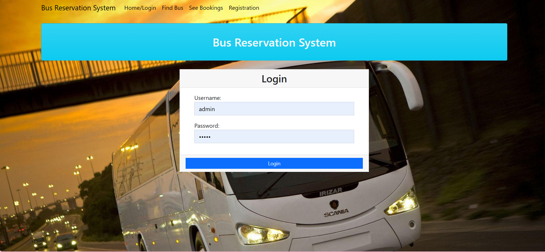
Homepage

Slide 10
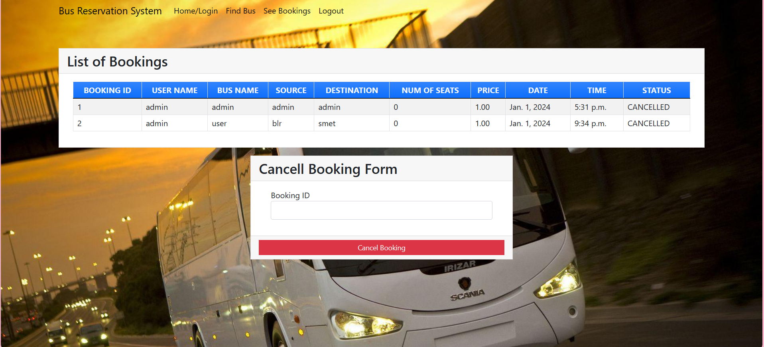
Service-Page

Slide 11
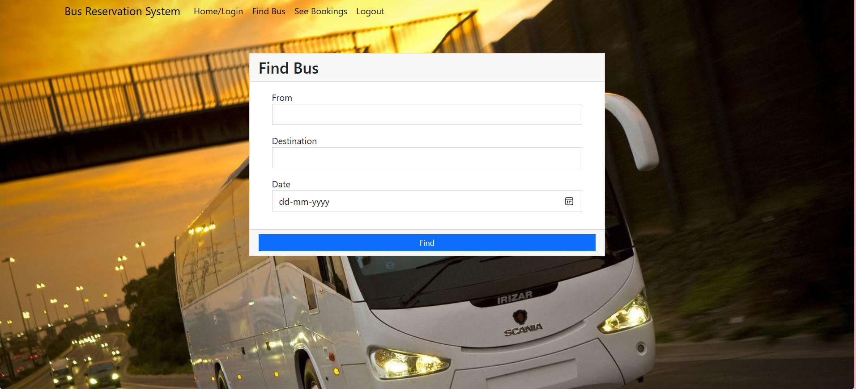
Departments-Page

Slide 12
Future Enhancements:
Advanced inventory control
Passenger information in real time
Sales management in real time
State of digital marketing tools
Comprehensive & well-documented API’s for integration

Slide 13
Conclusion
It can be observed that computer applications are very important in every field of
human endeavor. Here all the information about customer that made reservation
can be gotten just by clicking a button with this new system, some of the
difficulties encountered with the manual system are overcome. It will also reduce
the workload of the staff, reduce the time used for making reservation at the bus
terminal and also increase efficiency. The application also has the ability to update
records in various files automatically thereby relieving the company’s staff the
stress of working from file security of data.
Source : researchgate.net

Slide 14
Thank You!
Notes:
Thank You !!

